Slide 1
Employees v Independent Contractors
The Karshan Case
John Perry Tax Partner Ogier
Legal partner to The Federation of Irish Sport

Slide 2
Karshan case summary
Domino’s classified its drivers as self-employed contractors.
Revenue argued the drivers were in fact employees for tax purposes.
Supreme Court was tasked with determining whether they were engaged under a contract “of service” (employee) or “for service” (contractors).
The judgement established a structured five-point test, based on the actual working relationship and not merely the written contract between the two parties.
Employees v Independent Contractors

Slide 3
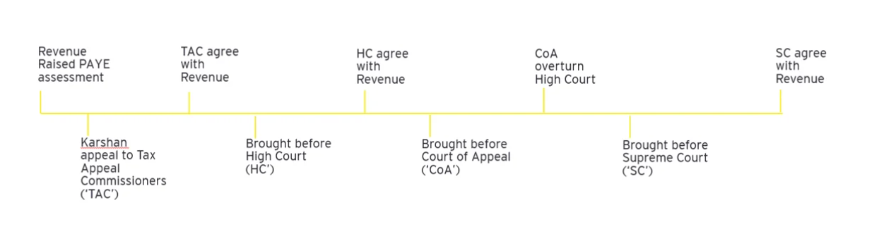
Case Background
Both parties had invested significant time and effort as illustrated in the chronology of appeals from 2018 to 2025
In light of Revenue’s persistence and ultimate success in this case, their focus will be to ensure PAYE compliance for all companies.
Employees v Independent Contractors

Slide 4
Potential implications
Employer
Liable for employees PRSI (ER Rate is 11.25% for Class A), PAYE, USC
May be required to pay for annual leave
Required to enrol employees in the auto enrolment pension scheme, if they are not part of one from 1 January 2026
May be liable for employee benefits such as overtime pay, sick leave pay and health insurance
Employee
Subject to payroll taxes, such as PAYE, PRSI (EE rate is 4.2% for Class A), USC
Employees v Independent Contractors

Slide 5
Supreme Court five-point test
Does the contract involve the exchange of wage or other remuneration for work?
Is the worker agreeing to provide his or her own services, rather than the services of a third party?
Does the employer exercise sufficient control over the individual to render the agreement capable of being an employment relationship?
Are the terms of the contract, viewed in light of the actual working arrangements, consistent with employment rather than self-employment?
Is there anything in the relevant legislative regime that requires the court to adjust the previous conclusions?
Employees v Independent Contractors

Slide 6
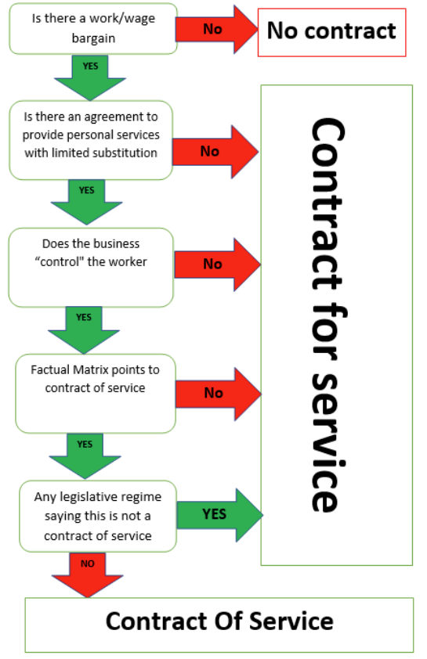
Decision tree analysis from the Karshan case?
Justice Murray stated "I think the right approach is to view the first three questions I have just identified as a filter in the form of preliminary questions which, if any one is answered negatively means that there can be no contract of employment, but if all are answered affirmatively, allow the interrogation of all of the facts and circumstances to ascertain the true nature of the relationship".
Employees v Independent Contractors

Slide 7
Revenue Disclosure Opportunity
Time-limited disclosure opportunity allowing employers to regularise their payroll tax for 2024-2025 without interest or penalties, where genuine misclassification occurred.
Option available until 30 January 2026.
Employees v Independent Contractors

Slide 8
Characteristics of Employees
Being under direction or control of employer
Supplying labour only and receiving a fixed wage
Being unable to subcontract their work
Not supplying equipment (other than small tools)
Having no opportunity for profit from personal efficiency
Working set hours with potential entitlement to sick pay
Being paid expenses
Working for one main business with no ability to work for any other business
Employees v Independent Contractors

Slide 9
Characteristics of independent contractors
Individual owns their own business
Individual takes on the financial risk of the work
Individual manages their own work and investment
Ability to hire others to complete the work or ability to contract out work
Working for multiple clients
Setting prices for work
Providing their own insurance
Controlling their work hours and work methodology
Providing materials and equipment to enable them to complete their work
Employees v Independent Contractors

Slide 10
Personal service company (PSC)
Contractors may provide their services through a company or as an individual under Schedule D Case I or II (independent contractor)
A PSC is where an individual contractor provides their services through a limited company, incorporated and resident for tax in Ireland
Revenue have confirmed they will not look through the corporate veil unless it has been pierced or is ineffective
PSC needs to invoice customer for services rendered
PSC needs to file VAT, corporation tax, PAYE/PRSI returns where appropriate
Employees v Independent Contractors

Slide 11
Implications for Employment Law
Employers must remember that reclassifying a worker as an employee has employment law consequences
Unfair dismissal claims
Holiday pay liabilities
Minimum wage issues
Claims for backdated employment rights
Working time obligations
Notice payments
Redundancy entitlements
Employees v Independent Contractors

Slide 12
Key Takeaways for Employers
Department of Social Protection, Revenue Commissioners and the Workplace Protection Commission have incorporated the Supreme Court ruling into their work practices.
Tax and employment law tests are now aligned.
Review all contractor arrangements.
Misclassification can lead to major tax and PRSI liabilities for individuals and employers
Use the Revenue disclosure window if appropriate.
Obtain professional legal and tax advice to normalise affairs
Employees v Independent Contractors

Slide 13
Settlement
The calculation of settlement notes that liabilities are to be calculated as follows:
Income tax - 20% on gross amount paid
USC - 3.5% blended rate on gross amount paid
Employee PRSI – 4.2% for Class A
Employer PRSI – 8.9% or 11.15% depending on weekly earnings
Employees v Independent Contractors

Slide 14
Appendix – Example 1
A construction company, C Co, engages a general labourer, James, to work on a site.
James is to be paid an hourly rate.
James cannot send someone else in his place.
C Co’s foreman determines the hours that will be worked.
James does not supply equipment and supplies labour only.
Employees v Independent Contractors

Slide 15
Appendix – Example 1 (cont.)
1. Work/wage Bargain | Yes. James is paid an hourly rate to undertake work
2. Personal service | Yes. James cannot send someone else in his place
3. Control | Yes. The site foreman, on behalf of C Co., determines how, where, what and when the work is done.
4. All the circumstances of the employment. | Yes. The contract of engagement is drafted as a self-employment contract with payments made to James reported through the RCT portal by C Co. The facts of the case do not support this position. In addition to the facts detailed under questions 1 to 3, James cannot profit beyond his set hourly rate, is told what he’s being paid by the foreman, uses tools supplied by C Co and is insured similar to an employee.
5. Legislative context | N/A. There is no legislation that requires an adjustment or supplement to any of the questions above
James will be an employee. | PAYE should be applied by C Co.
Employees v Independent Contractors

Slide 16
Appendix – Example 2
Richard works as a plasterer for B Co, a building company, on a labour only basis.
He is paid on a daily basis.
He takes his instructions from the site foreman.
Richard is not free to provide someone else to perform his duties.
Employees v Independent Contractors

Slide 17
Appendix – Example 2 (cont.)
1. Work/wage Bargain | Yes. Richard is paid a set daily fee to undertake work
2. Personal service | Yes. Richard cannot send someone else instead
3. Control | Yes. The site foreman, on behalf of B Co., tells Richard where, when and what to do. As a skilled tradesman, the foreman does not direct him how to do the work, but this is the only element of the work which is controlled by Richard.
4. All the circumstances of the employment. | Yes. The contract of engagement is drafted as a self-employment contract with payments made to Richard reported through the RCT portal by B Co. The facts of the case do not support this position. In addition to the facts detailed under questions 1 to 3, Richard cannot profit beyond his set weekly wage if he does things more efficiently. He is insured as an employee of B Co who include him in the CIF pension scheme. The materials used by Richard are provided by B Co
5. Legislative context | N/A. There is no legislation that requires an adjustment or supplement to any of the questions above.
Richard will be an employee. | PAYE should be applied by B Co.
Employees v Independent Contractors

Slide 18
Appendix – Example 3
Peter works as an electrician for B Co.
He supplies labour, materials and his own tools.
He is paid a set fee to wire each house.
He takes his instructions on what house to wire next from the site foreman.
There are no restrictions on who undertakes the work Peter has been contracted to do.
Employees v Independent Contractors

Slide 19
Appendix – Example 3 (cont.)
1. Work/wage Bargain | Yes. Peter is paid an hourly rate to undertake work
2. Personal service | No. There are no restrictions on who does the work so it’s not a ‘personal service’.
3. Control | N/A. As the answer was ‘No’ to one of the first three questions, the contract is not indicative of an employment contract, so the remainder of the questions do not need to be considered.
4. All the circumstances of the employment. | N/A.
5. Legislative context | N/A.
James will be self-employed. | PAYE should NOT be applied by C Co. Payments made to Peter are reported through the RCT portal by B Co with RCT deducted as necessary.
Employees v Independent Contractors

Slide 20
Appendix – Example 4
Andrew, an actor, was engaged to provide a workshop to transition year students in a secondary school.
He provides his own material, his own insurance, can send a substitute to carry out these duties.
He informs the school of the rates and his availability.
He is free to take up similar work at the same time with other businesses
Employees v Independent Contractors

Slide 21
Appendix – Example 4 (cont.)
1. Work/wage Bargain | Yes. Andrew is paid a set fee to undertake work
2. Personal service | No. Andrew can send a substitute to provide the service.
3. Control | No. While this test does not need to be examined, commentary is included for completeness. Andrew is not directed by the school as to what work should be done, or how it should be done. As the workshops are carried out during school hours and given the nature of the work, the workshop must be carried out in the school premises.
4. All the circumstances of the employment. | The written agreement does not specify whether it is a contract for/of employment, however, applying the framework such that 2 of the filter questions are answered negatively, it is a contract for service.
5. Legislative context | N/A. There is no legislation that requires an adjustment or supplement to any of the questions above
Andrew will be self-employed. | The school can pay Andrew on receipt of an Invoice and a tax clearance certificate without the operation of PAYE. Andrew is required to register as a self-employed individual and account for income tax in the normal manner.
25
Employees v Independent Contractors

Slide 22
Appendix – Example 5
Rachel is self-employed as a partner in a solicitor practice and returns her partnership income under self-assessment.
She takes a position on a State board, appointed by a Government Minister.
Rachel is paid on a session rate basis per half day. The duties of the board members are laid down in statute.
Rachel is not free to provide someone else to attend the board meetings, but some duties in preparation for the meeting are carried out by the firm’s staff
Employees v Independent Contractors

Slide 23
Appendix – Example 5 (cont.)
1. Work/wage Bargain | Yes. Rachel is paid a set fee to undertake work
2. Personal service | No. While Rachel cannot send someone else to attend meetings, her staff carry out elements of her duties, including research, and she uses the resources of the practice to complete her work. Her access to these resources was one of the requirements for appointment to the Board.
3. Control | Yes. The functions of the board are laid down in statute. Rachel has been engaged because of her specialist legal knowledge. As a skilled professional, Rachel is not directed as to how to do the work.
4. All the circumstances of the employment. | N/A. As the answer to number two is ‘no’, this step does not need to be considered.
5. Legislative context | Yes. Board members of State Bodies are “office holders”. Section 112 TCA 1997 provides that office holder income is always taxable as Schedule E income and subject to PAYE.
James is an office holder. | PAYE should be applied by the State Department.
Employees v Independent Contractors

Slide 24
Questions
On Staffing & Roles
For an admin person working 15 - 18 hours per week for the club. Working from home some days and some days at the club. If they are being paid each month by the club for hours worked like this, do they class as sub-contractor or employee?
Does the type of work impact on whether or not it’s a contractor or FTE... e.g.; coaching (1 to1 or group) vs club tennis administration?
Employees v Independent Contractors

Slide 25
Questions
On Status & The 5-Point Framework
If a coach is coaching at a number of clubs and doing their own tax return each year etc does this mean their self-employed status is confirmed and they are not an employee of any of the clubs themselves?
What is Revenue's default position - coaches should be employees?
What specific factors will Revenue look at when applying their 5-point framework to tennis clubs?
Employees v Independent Contractors

Slide 26
Questions
On Status & The 5-Point Framework (cont.)
If the club owns courts & allocates time to coaching, how can control over coaching be proved to Revenue - specific wording in a clause in contract or can it be proven?
I have looked at the detailed revenue guidelines and the scenarios provided by Revenue. It strikes me that apart from the 'being able to delegate work' coaches fall into the contractor category. If we were to amend their contract to allow them to delegate, could we argue our case successfully in case of a Revenue audit?
Employees v Independent Contractors

Slide 27
Questions
On Coach Profiles
We have a number of coaches that have different profiles—how are these viewed?
Coaches that are resident in NI and have other clients.
Coaches that are resident in NI and only work for MLTCC.
Coaches that live in ROI and are paid on hours attended and a monthly fee for administration.
Coaches that live in ROI and are paid on hours attended only.
Foreign Nationals
< 30 days
30-183 days
Treaty
Employees v Independent Contractors

Slide 28
Questions
On Coach Profiles (cont.)
The club runs several coaching courses and controls the hours that the coaches work. The coaches have their own insurance, but the club will supply the equipment. Where do we stand?
Employees v Independent Contractors

Slide 29
Questions
On Private Coaching
How will Revenue expect clubs to treat private coaching by club coaches (1) if the coach is an employee or (2) if coach is a contractor?
A coach engaged by a club member for One-on-One coaching - not paid through or booked through the club. Presumably private coaching would have to be included as part of the PAYE system if we are to make them employees
Employees v Independent Contractors

Slide 30
Questions
On Financials & Retrospective Tax
If a coach is deemed an employee, how to do we calculate the Tax etc when we don't have their Tax allowance certs? Could you do a mock up a Tax calculation of a coach who earned €30k as a contractor in 2025 but is now deemed an employee under this ruling.
We are only being made aware of this ruling now. Why are revenue looking for tax retrospectively for 2024 and 2025.? This seems very unfair.
If contracted coaches are deemed employees for 2024 and 2025, this is potentially a very heavy financial burden on clubs, that we may not be able to pay. How do we deal with this with Revenue?
Employees v Independent Contractors

Slide 31
Questions
On Financials & Retrospective Tax (cont.)
For contracted coaches that no longer work for us, but may be deemed as employees when working for us in 2024 or 2025, do we have to make a submission for them?
For contracted coaches deemed as employees under this ruling, should we move them to employees now from 1 January 2026?
Employees v Independent Contractors

Slide 32
Questions
On Club Management
How to manage the challenge of a small volunteer organisation that changes every year (committee) to managing employees (legal, Revenue implications, cost & overhead implications). i.e. what supports are available?
Could TI support the Clubs by providing an employee and contractor contract template?
Employees v Independent Contractors

Slide 33
Questions
Suspected Concerns from Coaches
Timing of Filings: Reassurance for those who have already filed Form 11s for 2024, or those who don't realise 2025 taxes aren't due until late 2026.
Independence: What is the best advice for those who do not want to be an employee and want the freedom to work across multiple clubs?
Liabilities: If they didn’t pay taxes to date, will they get a bill from the revenue/club/Tennis Ireland for this?
Employees v Independent Contractors

Slide 34
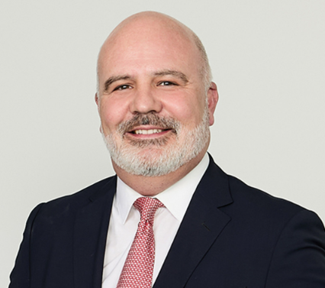


Key contacts
John Perry Tax Partner Dublin john.perry@ogier.com +353 1 584 6760 | Arthur Gaskin Tax Counsel Dublin arthur.gaskin@ogier.com +353 1 237 3087 | Edwina Hilton Associate Dublin edwina.hilton@ogier.com +353 1 232 1072
John is a Fellow Chartered Accountant, a Chartered Tax Adviser and has been awarded an MSc in Aviation Finance from UCD Graduate Business School. A former tax partner of a big 4 accounting firm, he was appointed as an Assistant Professor at Dublin City University and is a member of the Adjunct Faculty at University College Dublin. John contributes to numerous publications and has lectured on behalf of the Irish Tax Institute and the Law Society of Ireland. John qualified as a chartered accountant whist working in the tax department of a Big 4 accountancy firm in Jersey. With more than 20 years of experience in the financial services industry, John specialises in advising on the accounting, tax and regulatory aspects of asset management. John has acted for a wide range of industry participants, including asset managers, financial institutions, trustees, private equity providers, and fund administrators. | Arthur is a senior finance and tax professional with more than 30 years of international and domestic experience either working in practice and industry. He is a fellow of Chartered Accountants Ireland, a Chartered Tax Advisor of the Irish Taxation Institute and he was a member of the inaugural class of the MSc in Aviation Finance from UCD Graduate Business School (1st Class). Arthur specialises in advising clients on finance, tax, contract and regulatory matters across numerous industries. This includes aviation, financial services, funds, banking, private equity and real estate. His clients have included a wide range of industry participants both domestically and internationally. Arthur contributed a chapter on Risk in Aviation Finance to the 5th and 6th editions of Aircraft Financing, published by Bloomsbury Publishing in London 2021 and 2026. Arthur has lectured extensively on finance and tax matters at Chartered Accountants Ireland and at the UCD Michael Smurfit College. | Edwina is an associate in the tax practice of Ogier in Ireland, specialising in investment management, structured finance and aviation. Prior to joining Ogier in Ireland, Edwina trained and worked at a large international law firm in Dublin, where she was admitted as a solicitor in Ireland (2021) and in England and Wales (2023), where she is non practising. Edwina read Law with French at Trinity College Dublin and Université Paris-Panthéon-Assas. She is currently pursuing her qualification as a Chartered Tax Adviser with the Irish Tax Institute in Dublin.
Employees v Independent Contractors

Slide 35

Key contacts
Paddy Murphy Managing Associate Dublin Paddy.murphy@ogier.com +353 1 584 6311
Paddy is a specialist sports lawyer and leads the Sports Law practice in Ogier's Irish office. He advises sports national governing bodies, clubs and businesses in the sports industry on contentious and non-contentious issues. Paddy has significant experience of advising clients in the sports industry. His experience includes advocating before sports arbitration tribunals, acting in defending players at disciplinary hearings, acting as independent legal assessor in disciplinary hearings, drafting constitutions and complaint and disciplinary policies for Sports National Governing bodies, advising on child protection matters within sport and advising on selection policies for major international competition.
Employees v Independent Contractors

